Slide 1
SMART MEDICINE REMINDER FOR ELDERLY PEOPLE USING IOT
BY TEAM: “PINGS WITH THINGS”
P. Bhavana Roll No: 187Y1A04C6
B. Nikhitha Roll No: 187Y1A0490
Shaik Khaja Ayaz Roll No: 187Y1A0411

Slide 2
INTRODUCTION:
In day-to-day life most of the people need to take medicines which was not there in past couple of years and the reason behind this is diseases are increasing in large amount. So sooner or later many people come in contact with these diseases. Life span of humans became less because of such diseases and to overcome or to live a better life we need to take medicines regularly and also in large amount. We need to be in advice of Doctor who tells us to take desired pills in desired way so that patients face problems like forgetting pills to take at right time and also when Doctor changes the prescription of medicine patients have to remember the new schedule of medicine. This problem of forgetting to take pills at right time, taking wrong medicines and accidentally taking of expired medicine causes health issues of patient and this leads to suffer from unhealthy life.

Slide 3
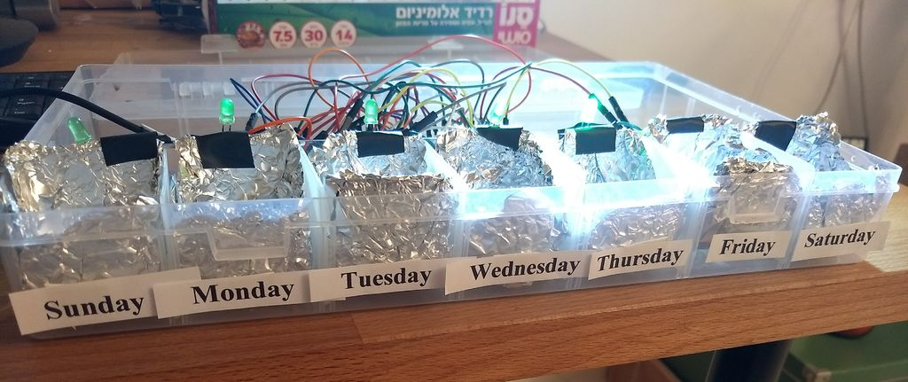
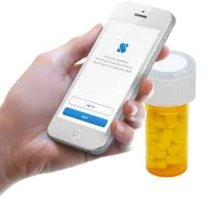
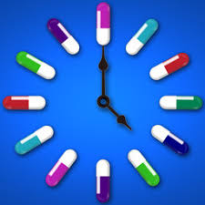
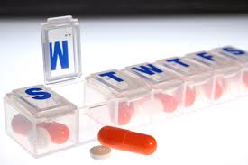

Slide 4
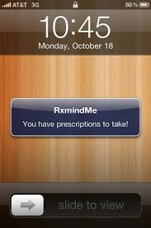
ABSTRACT
In modern society, busy life has made people forget many things in day to day life. The elderly people and the people victims of chronicle diseases who need to take the medicines timely without missing are suffering from dementia, which is forgetting things in their daily routine. Considering this situation study has been done in this. Paper reviewing the technologies of home health care which are currently used for improving this situation by reminding the scheduled of medicine, remote monitoring and update new medicine Consumption data of patients, which can be done by prescriber through IOT.

Slide 5
Block Diagram:
RTC Module
Node MCU
IBM Cloud
Mobile app
LEDs
Buzzer

Slide 6
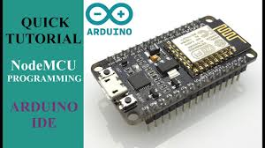
Hardware:
Node MCU :-
The Node MCU device kit is a development board with the ESP8266 mounted on it. It also has a USB to Serial convertor chip on board. This removes the need of the FTDI USB to Serial Converter. Also, it has a voltage converter on board for converting the 5V supplied by the USB port to 3.3V input required by the ESP8266.

Slide 7
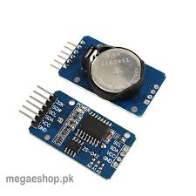
SPECIFICATIONS
Supply 5V DC.
Completely Manages All Timekeeping Functions.
Real-Time Clock Counts Seconds, Minutes, Hours, Date of the Month, Month, Day of the Week, and Year with Leap-Year Compensation Valid Up to 2100.
56-Byte, Battery-Backed, General-Purpose RAM with Unlimited Writes.
Programmable Square-Wave Output Signal.
Simple Serial Port Interfaces to Most Microcontrollers.
I2C Serial Interface.
Low Power Operation Extends Battery Backup Run Time.
Consumes Less than 500nA in Battery-Backup Mode with Oscillator Running.
Automatic Power-Fail Detect and Switch Circuitry.

Slide 8
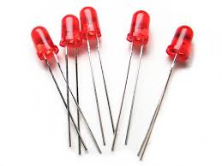
Leds :-
Diode LED emitting infrared waves, this component has high reliability and high radiant intensity, its peak wavelength is p=3.7e-5in and 1.00e-7in lead spacing. Its applications are in free air transmission system or infrared applied system.

Slide 9
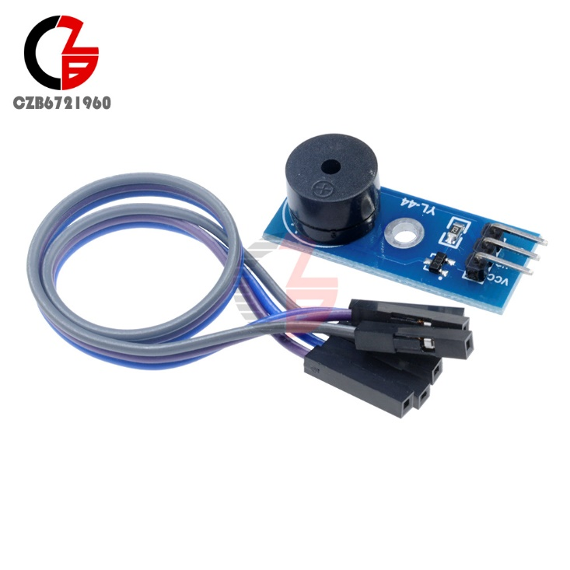
BUZZER:
A buzzer or beeper is an audio signalling device, which may be mechanical, electromechanical, or piezoelectric (piezo for short). Typical uses of buzzers and beepers include alarm devices, timers, and confirmation of user input such as a mouse click or keystroke.

Slide 10
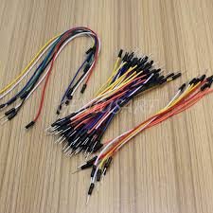
Connecting Wires :-
A jump wire (also known as jumper wire, or jumper) is an electrical wire, or group of them in a cable, with a connector or pin at each end (or sometimes without them – simply "tinned"), which is normally used to interconnect the components of a breadboard or other prototype or test circuit, internally or with other equipment or components, without soldering.

Slide 11
Software:-
Arduino IDE :-
ARDUINO is an open-source prototyping platform based on easy-to-use hardware and software.
The Arduino IDE supports the languages C and C++ using special rules of code structuring.
IBM Cloud Services :-An IoT platform is a multi-layer technology that enables straightforward provisioning, management, and automation of connected devices within the Internet of Things universe. It basically connects your hardware, however diverse, to the cloud by using flexible connectivity options, enterprise-grade security mechanisms, and broad data processing powers.

Slide 12
NODE RED:
Node-RED is a flow-based development tool for visual programming developed originally by IBM for wiring together hardware devices, APIs and online services as part of the Internet of Things. Node-RED provides a web browser-based flow editor, which can be used to create JavaScript functions.
MIT App inventer-2 :-
App Inventor for Android is an open-source web application originally provided by Google, and now maintained by the Massachusetts Institute of Technology (MIT), which allows newcomers to computer programming to create software applicationsfor the Android operating system (OS).

Slide 13
ADVANTAGES:
Reminds Your Senior to Take Their Medication
Prevent Errors
29 Days of Meds, All in One Place
Easy to Use
Customization
CONCLUSION:
To improve the existing home health care technique number of monitoring technology has observed which leads to home health monitoring system. IOT (Internet of Things) play a vital role in communicating the two devices, the use of messaging standard and
communication protocol we can securely transfer the important messages regarding to health. open source IOT cloud will be effective for storing sensors data,the benefit of digitally storing is the retrieving of data is easy and faster manner in case of emergency for secure health

Slide 14
THANK YOU

